Slide 1
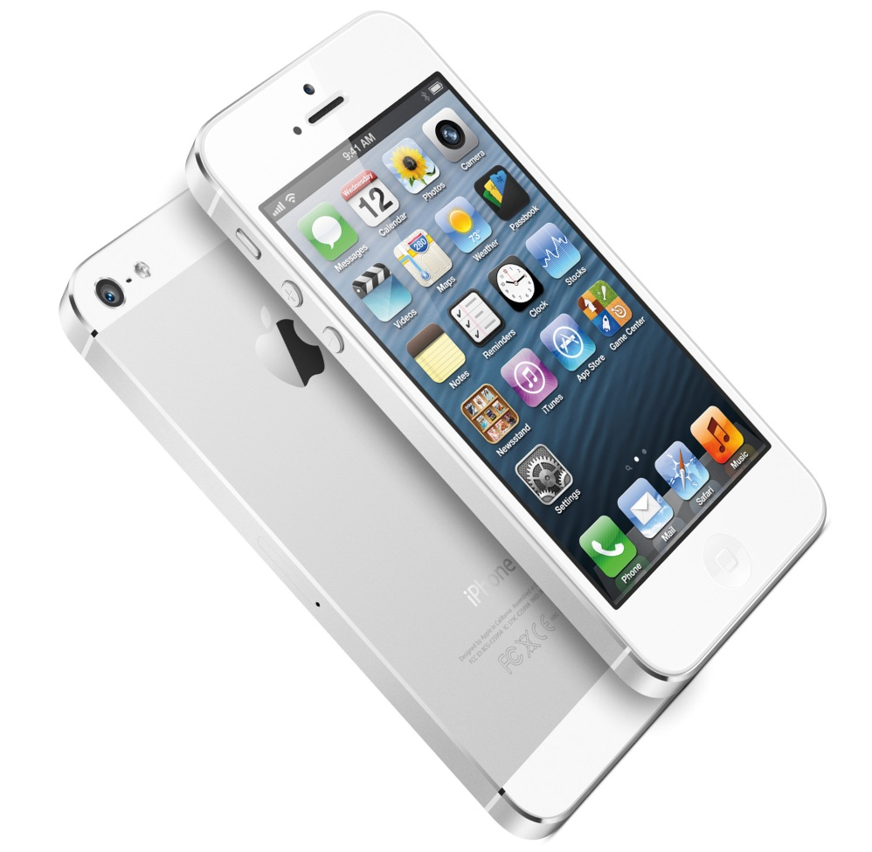
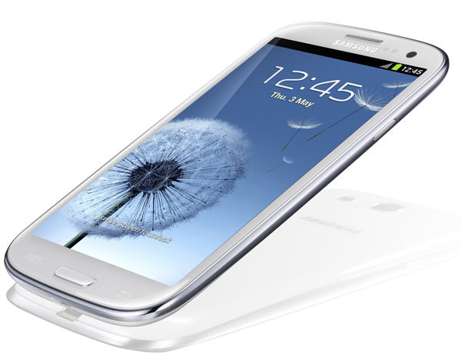
Samsung Galaxy
s3
IPhone 5
VS.

Slide 2
IPhone 5
Pros
Cons
-Light weight
-Effectively global 4G/LTE support
-Siri integration, Apple's new Assistant (a voice recognizing personal assistant)
-Fingerprint resistant
-Faster processor
-High Resolution Screen
-Large screen
-Short battery life
-Lack of signals- to send messages/calls
-Need new adapter or dock from IPhone 4S
-No new features from IPhone 4S
-Easy to scratch/crack
-Doesn’t have Sim card slot
-Problems with headphone jack

Slide 3
Samsung Galaxy
s3
Pros Cons
-Long battery life
-Light
-Large screen
-Data monitor
-Voice control
-File manager
-Removable battery
-Easy to crack/scratch
-Troubles with buttons
-Screen too large
-Feels `cheap` or `plastic-y`
-No shutter button on camera
-Less storage in phone
-Poor quality screen material

Slide 4
Samsung Galaxy s3
IPhone
-4.8 inches wide
-Price ranges from $179-279 (including plan)
-plastic
-130g (weight)
-441 pixels/inch
2GB of RAM
2,600 mAh (battery)
-2.31 inches wide
Prince ranges from, $199-649 (including plan)
Aluminum
112g (weight)
326 pixels/inch
1GB of RAM
1,440 mAh (battery)

Slide 5
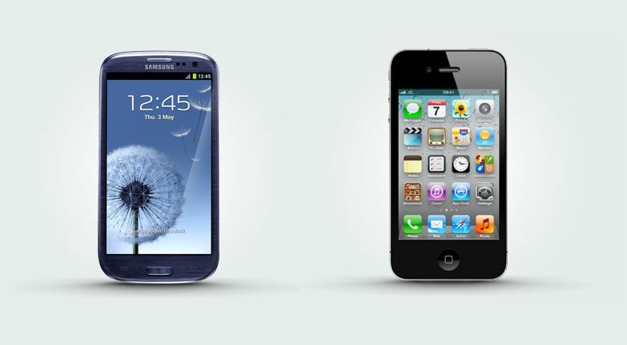
Which one I would choose:
I would choose the IPhone 5 because it’s cheaper in plan (according to Rogers) and I find that it is easier to use and keep track of your things. It is small and easier to hold, and the screen isn’t too big to handle.

